Slide 1
The Teaching of Language through Thinking and Literacy.
By Luciana Fernández
fernandezluve@yahoo.com

Slide 3
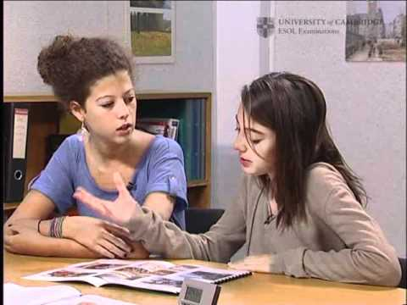

Slide 4
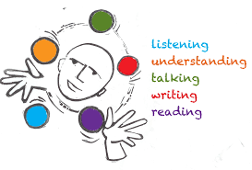
Rationale of the presentation: Key words.
LANGUAGE ACQUISITION
THINKING
VISUAL LITERACY

Slide 5
1. LANGUAGE ACQUISITION

Slide 6
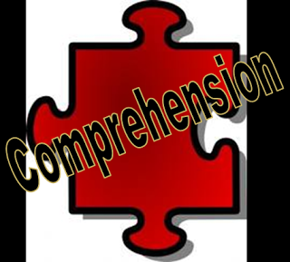
2. THINKING
THINKING = COMPREHENSION
DIFFERENT COMPREHENSION LEVELS

Slide 7
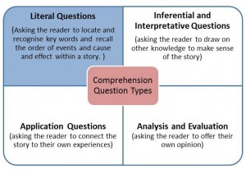

Slide 8
COMPREHENSION & THINKING: STRATEGIES – TOP 10
1. MAKING CONNECTIONS
2. MAKING PREDICTIONS
3. BEING FLUENT
4. MAKING INFERENCES AND DRAWING CONCLUSIONS
5. QUESTIONING
6. VISUALIZING
7. SUMMARIZING AND SYNTHESIZING
8. DECIDING WHAT IS RELEVANT AND WHAT IS NOT
9. HAVING THE WORDS (VOCABULARY)
10. SENSING

Slide 9
Schemata
Knowledge
Experiences
Feelings
Beliefs
Assumptions
Memories

Slide 10
Where do our students get information from?

Slide 12
3. VISUAL LITERACY
VISUALS
Photographs, paintings and drawings, graphic art (including everything from political cartoons to comic books to illustrations in children’s books), films, maps, videos and various kinds of charts and graphs.
LITERACY
The ability to COMPREHEND visuals.
All comprehension levels.

Slide 13
Using visuals in the classroom:
LANGUAGE
LITERACY
THINKING
Structures
Vocabulary
Reading, writing, listening and speaking.
Literacy strategies
Comprehension levels
21st century skills
Thinking levels – Bloom´s Taxonomy

Slide 14
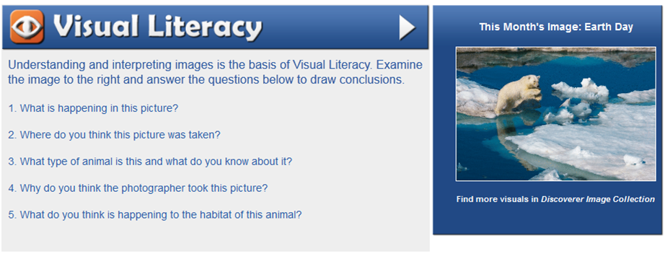

Slide 15
The Language of Thinking.
Sentence Starters & Language Frames

Slide 16
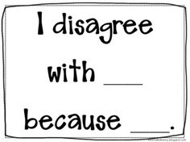
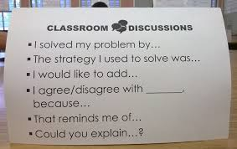

Slide 17
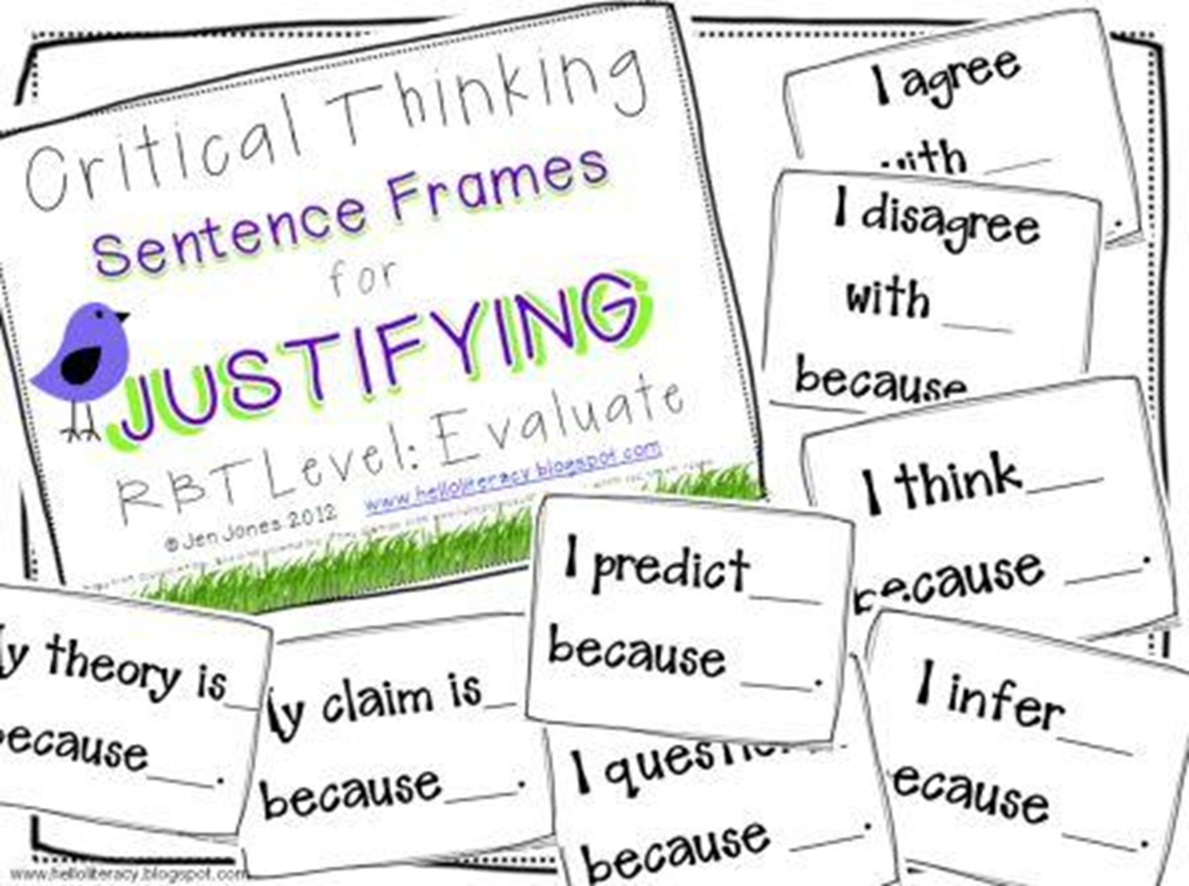

Slide 18
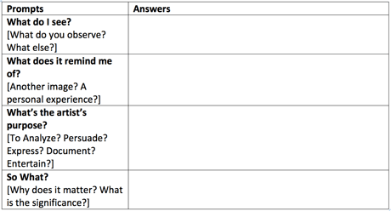

Slide 19
So, working with visuals and developing Visual Literacy helps my students:
Use language (vocabulary and structures) in a meaningful context.
Develop speaking, writing, listening and reading with a strong focus on communication.
Interact meaningfully with others using the target language.
Go beyond the literal level and deepen their thinking and understanding.
Think efficiently about the visuals they are exposed to every day.

Slide 20
Thanks for joining me today!
Luciana Fernández
fernandezluve@yahoo.com

